Slide 1
Introduction to Neural Networks
Ovidiu Calin

Slide 2
Artificial Intelligence
“The science and engineering of creating intelligent machines” - John McCarthy, 1956

Slide 3
Machine Learning
“Field of study that gives computers the ability to learn without being explicitly programmed” – Arthur Samuel, 1959
Capacity of extracting patterns from raw data

Slide 4
Brain-Inspired AI
An algorithm that takes its basic functionality from our understanding of how the brain operates

Slide 5

Biologic Neuron
The basic computational unit of the brain is a neuron
Neurons receive input signal from dendrites and produce output signal along axon, which interact with the dendrites of other neurons via synaptic weights
The neuron collects info through dendrites; if this is large enough the neuron fires.

Slide 6
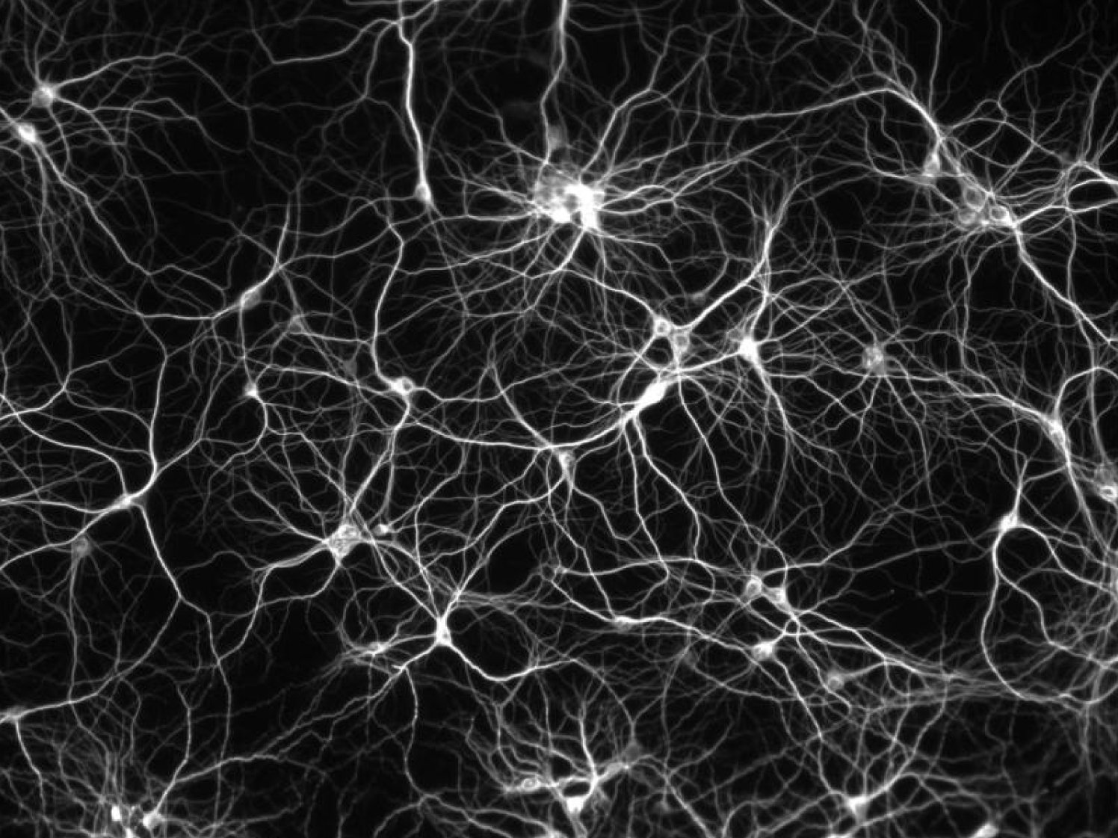
Neuron map
Neurons are connected with nearly 1014 – 1015 synapses
Synaptic weights – learnable & control influence strength
There are 86Billion neurons in the brain
This model inspired neural networks in Machine learning

Slide 7
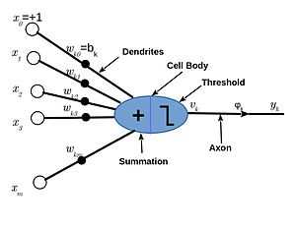
The artificial Neuron

Slide 8
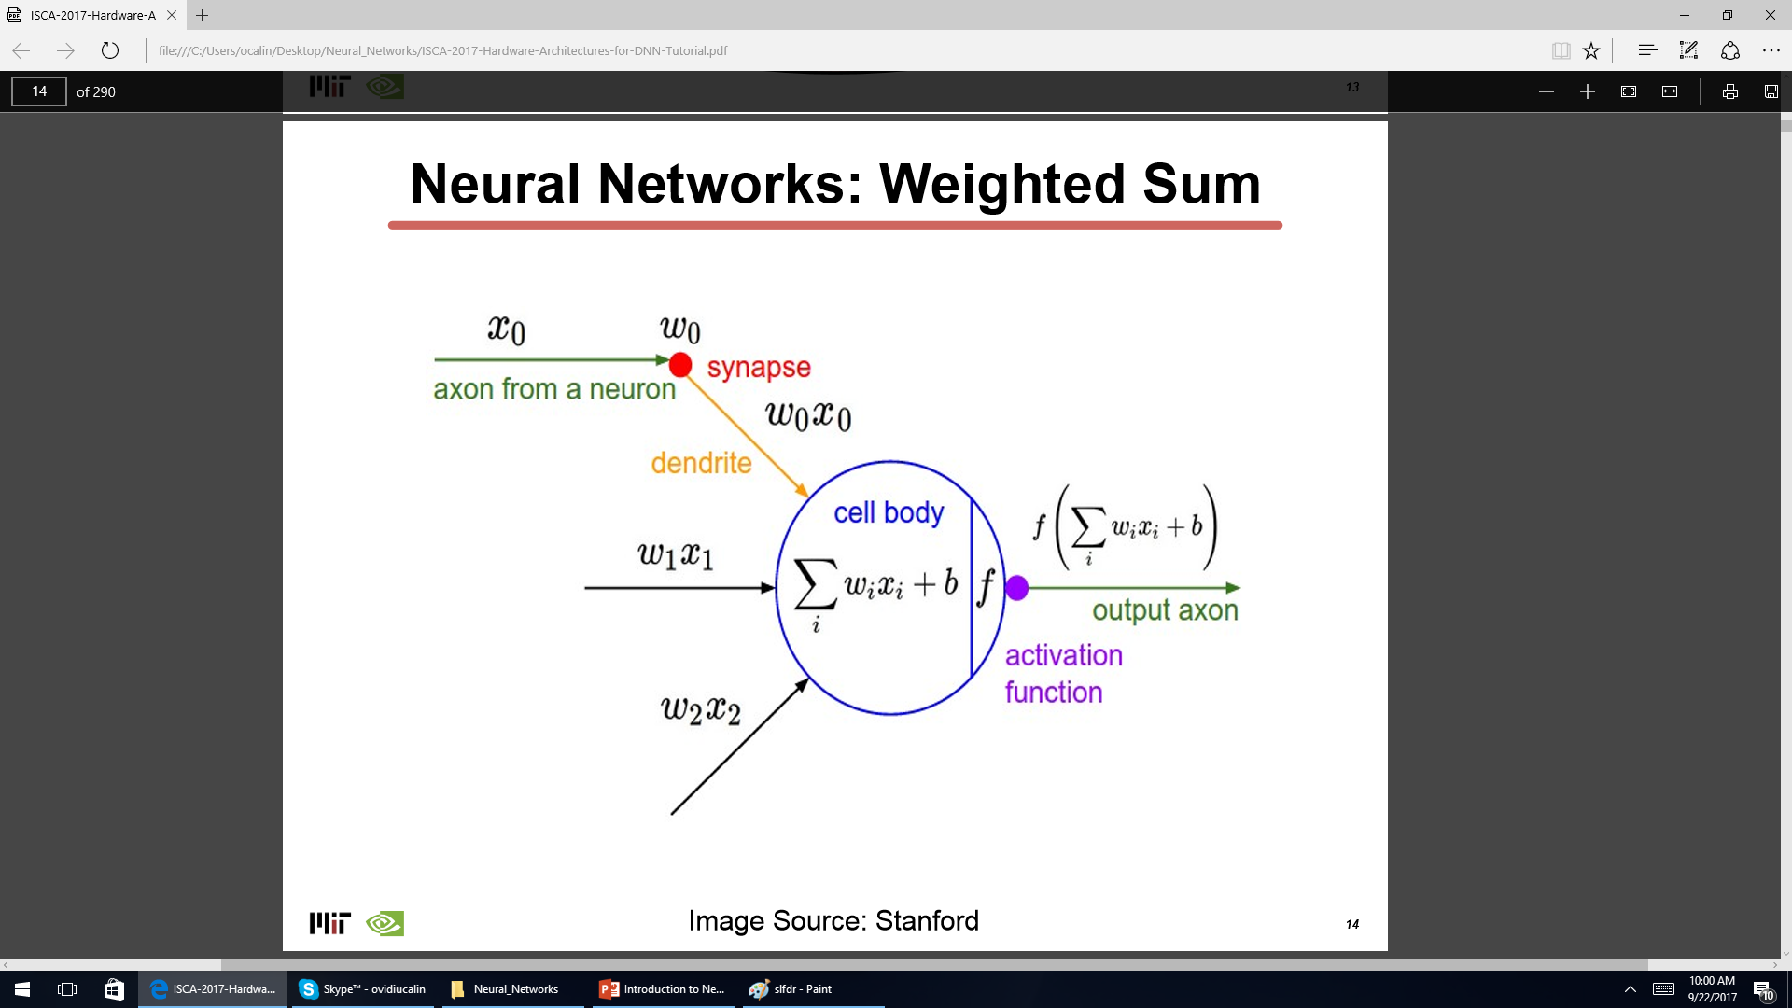

Slide 9
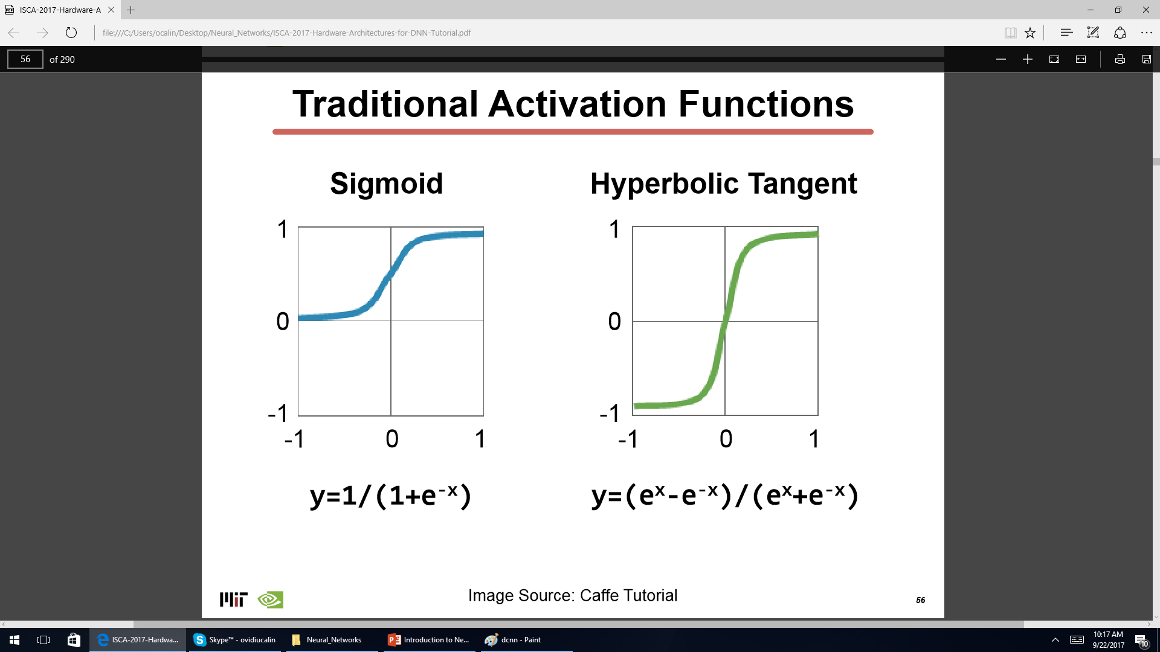

Slide 10
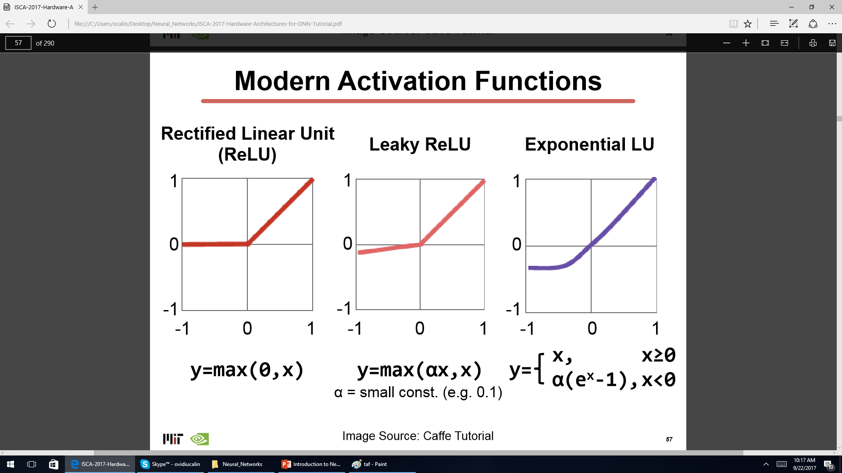

Slide 11

3-layer NEural network

Slide 12
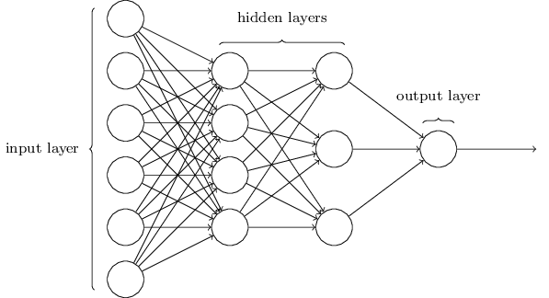
4-layer NEural network

Slide 13

Deep NEural network

Slide 14
Deep learning
Neural networks
Deep learning

Slide 15
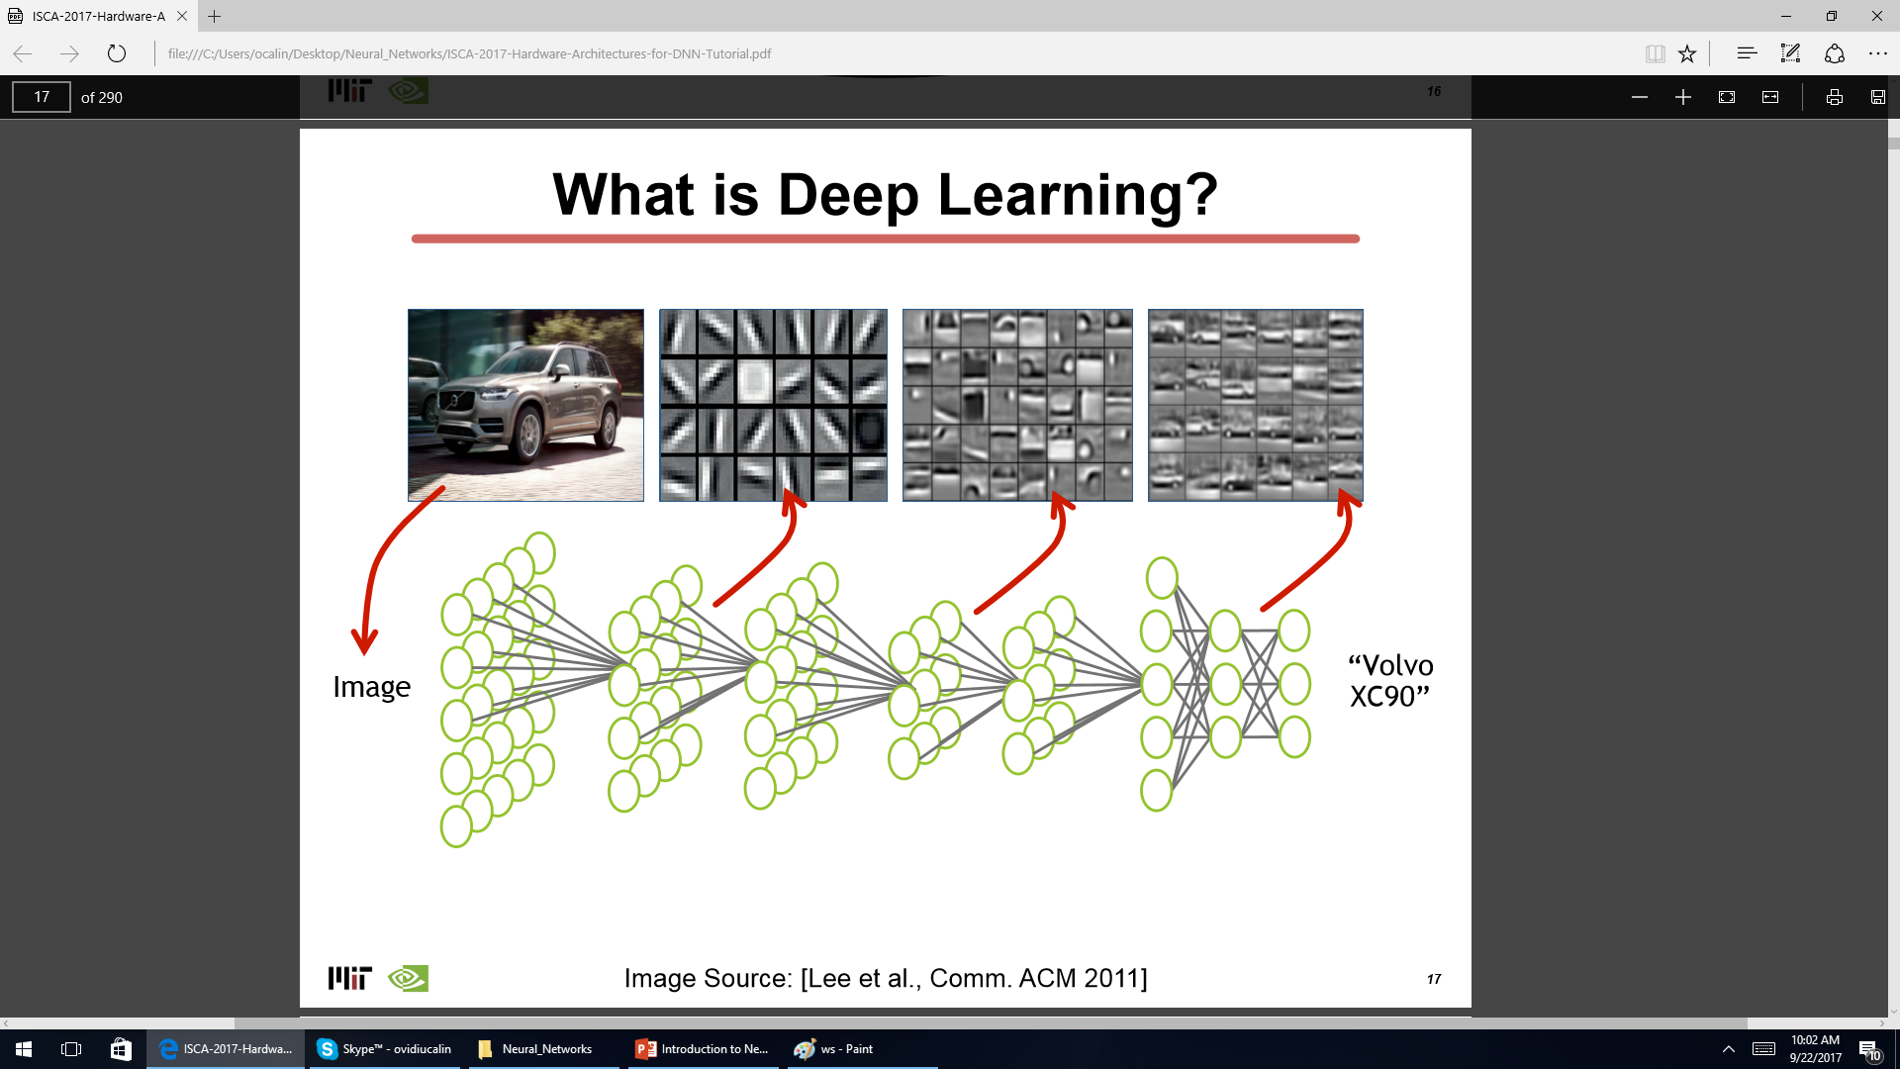

Slide 16
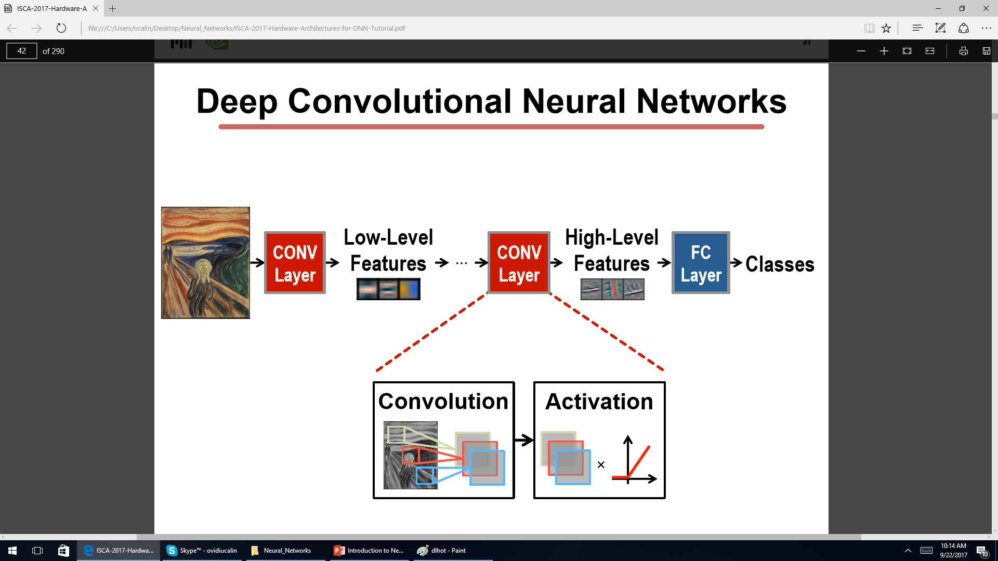

Slide 17
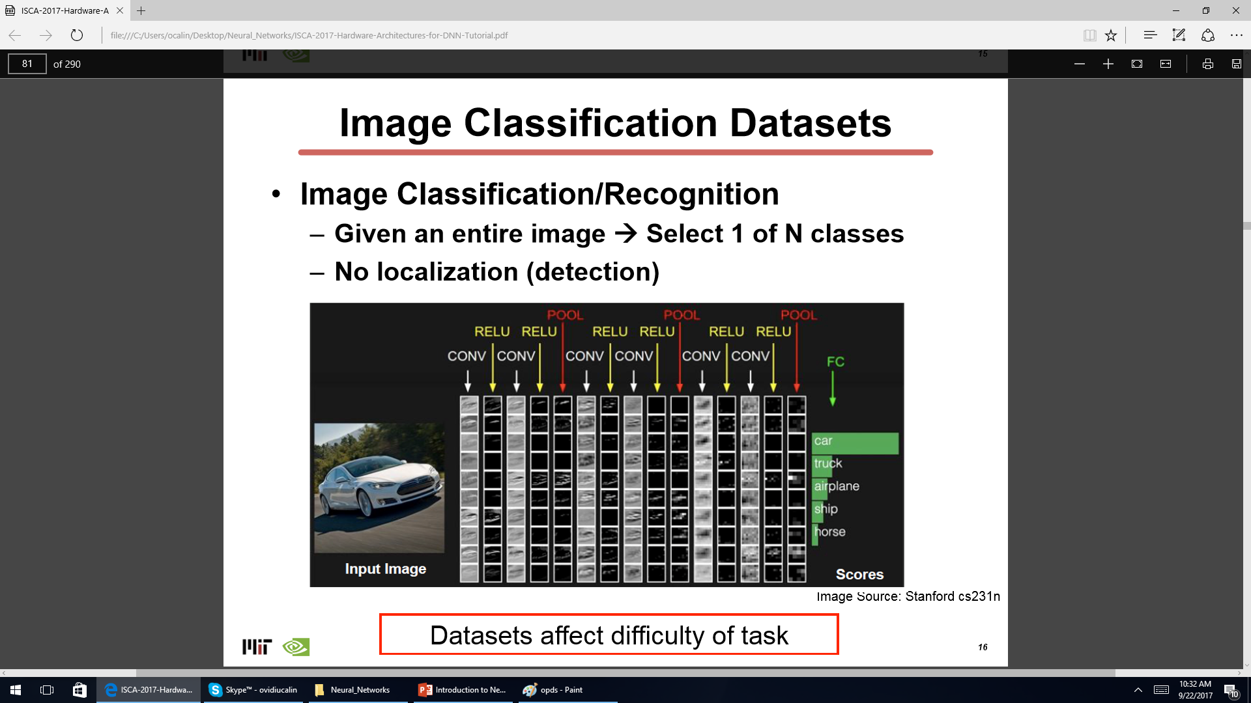

Slide 18
Deep learning applications
Image Classification: image to object class Recognition: same as classification (except for faces) Detection: assigning bounding boxes to objects Segmentation: assigning object class to every pixel
Speech & Language Speech Recognition: audio to text Translation Natural Language Processing: text to meaning Audio Generation: text to audio

Slide 19
Deep learning applications
Medical (Cancer Detection, Pre-Natal, MRI scans)
Finance (Trading, Energy Forecasting, Risk)
Infrastructure (Structure Safety and Traffic, self-diving cars, street view)
Weather Forecasting and Event Detection

Slide 20
Historical perspective – 3 waves
1st wave: cybernetics in the 1940s–1960s
2nd wave: connectionism in the 1980s–1990s
3rd wave: deep learning beginning in 2006-present

Slide 21
cybernetics (1940s–1960)
biological learning (McCulloch and Pitts neuron 1943, Hebb 1949 )
implementations of the perceptron (Rosenblatt 1958 ) allowing the training of a single neuron.
adaptive linear element (ADALINE) (Widrow and Hoff 1960)
Critics who observed ﬂaws in the above linear models (Minsky and Papert, 1969)

Slide 22
connectionism (1980s–1990s)
back-propagation algorithm to train a neural network with one or two hidden layers (Rumelhart 1986, LeCun, 1987 )
a large number of simple computational units can achieve intelligent behavior when networked together
unreasonable expectations in 1990s, investors were disappointed.

Slide 23
deep learning beginning (2006-today)
The Canadian Institute for Advanced Research (CIFAR) helped to keep neural networks research alive
INITIAtors of the deep learning current: Geoffrey Hinton (University of Toronto) Yoshua Bengio (University of Montreal) Yann LeCun (New York University).
deep neural networks outperformed competing AI systems based on other machine learning technologies.

Slide 24
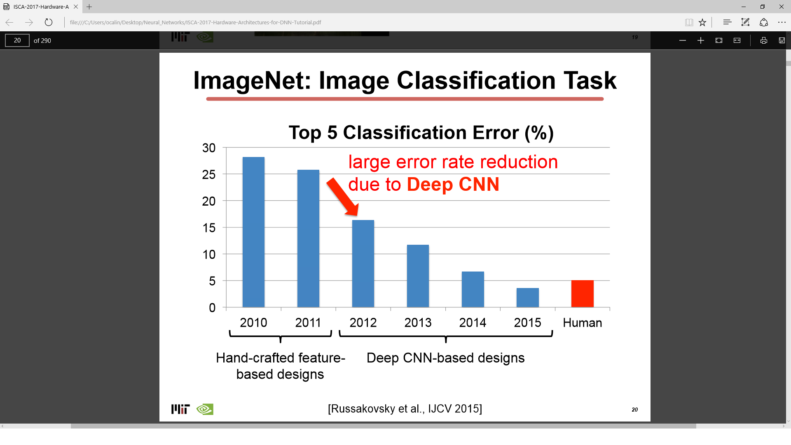

Slide 25
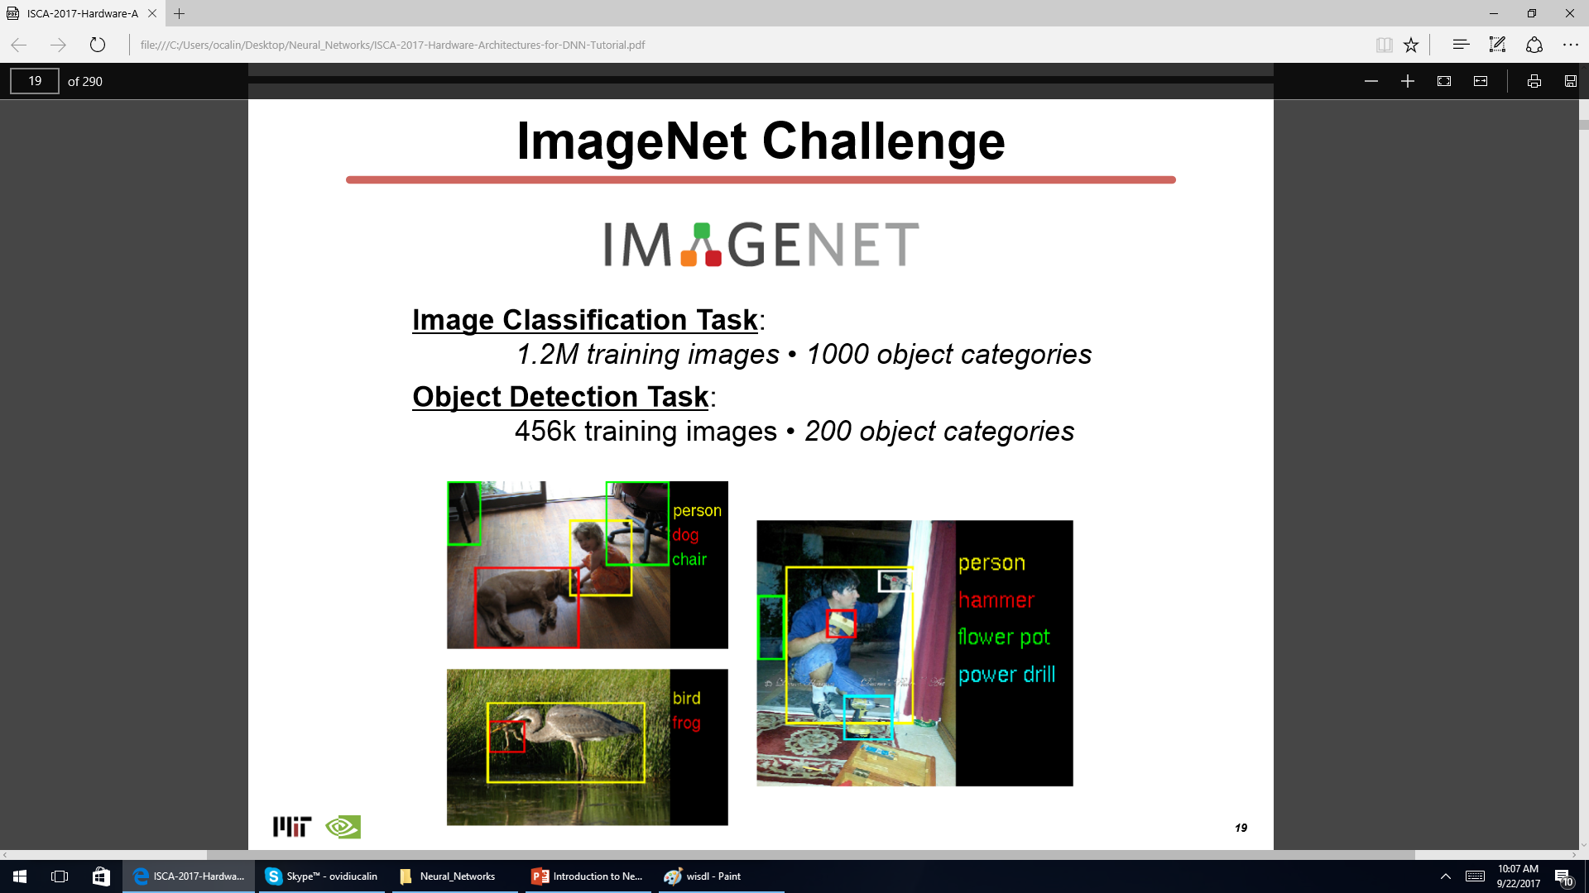

Slide 26
deep learning beginning (2006-today)
Tech giants (Google, Microsoft, Facebook, IBM, Baidu, Apple, Adobe, Netﬂix, NVIDIA, and NEC) joined the movement
applications of deep learning are highly proﬁtable
Not a single business will remain unaffected in the future

Slide 27
Paradigm change
Old: the rules are provided ahead of time by the programmer (computer defeats Garry Kasparov in 1997 )
New: the network learns by itself from Given training data sets – but how?

Slide 28
Recipe for the New paradigm
Training Data sets (pictures, sounds, letters, characters, etc. with labels)
NN model (feed forward, autoencoder, Hopfield Network, Boltzmann machine, etc.)
Cost (error) function – to be minimized w.r.t. the synaptic weights
Optimization procedure (gradient descent, annealing, hessian method, etc.)

Slide 29
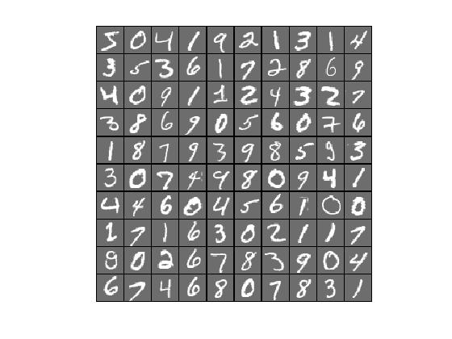
Training Data sets
Increased over time until The age of “Big Data”
Labelled and unlabeled data (supervised and unsupervised learning)
The MNIST dataset consists of scans of handwritten digits and associated labels describing which digit 0–9 is contained in each image (Lecun 1998)
28x28 pixels, 10 Classes 60,000 Training

Slide 30
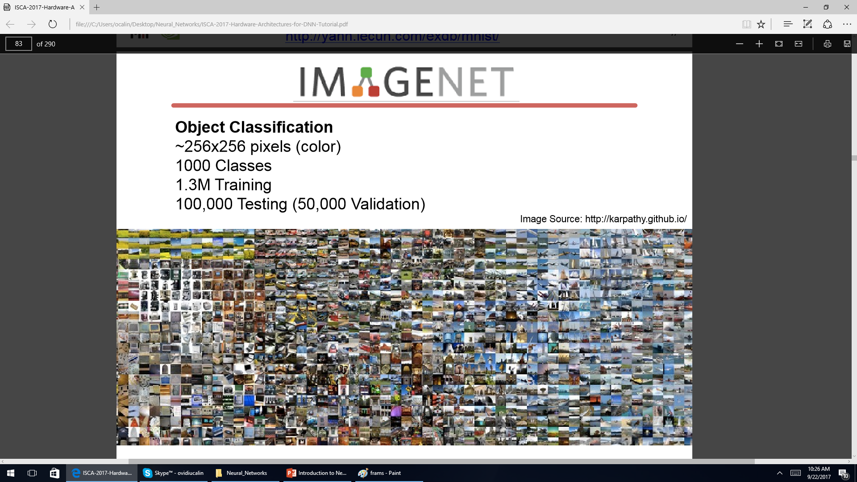

Slide 31
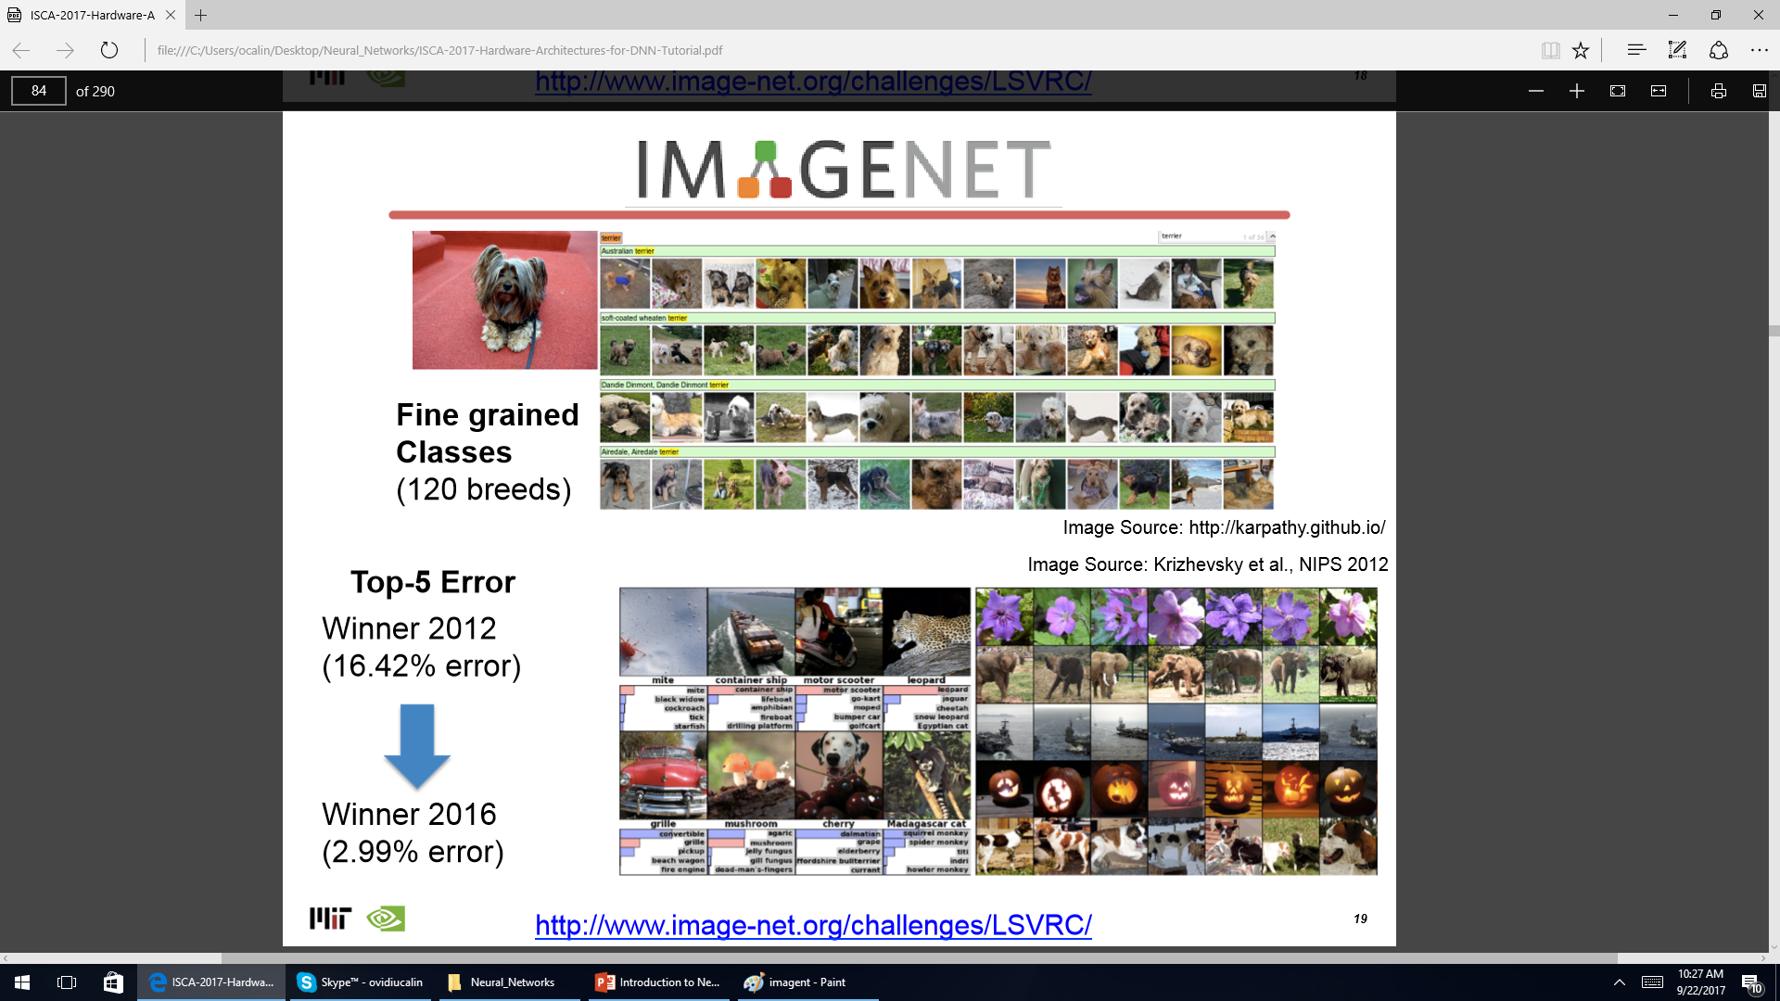

Slide 32
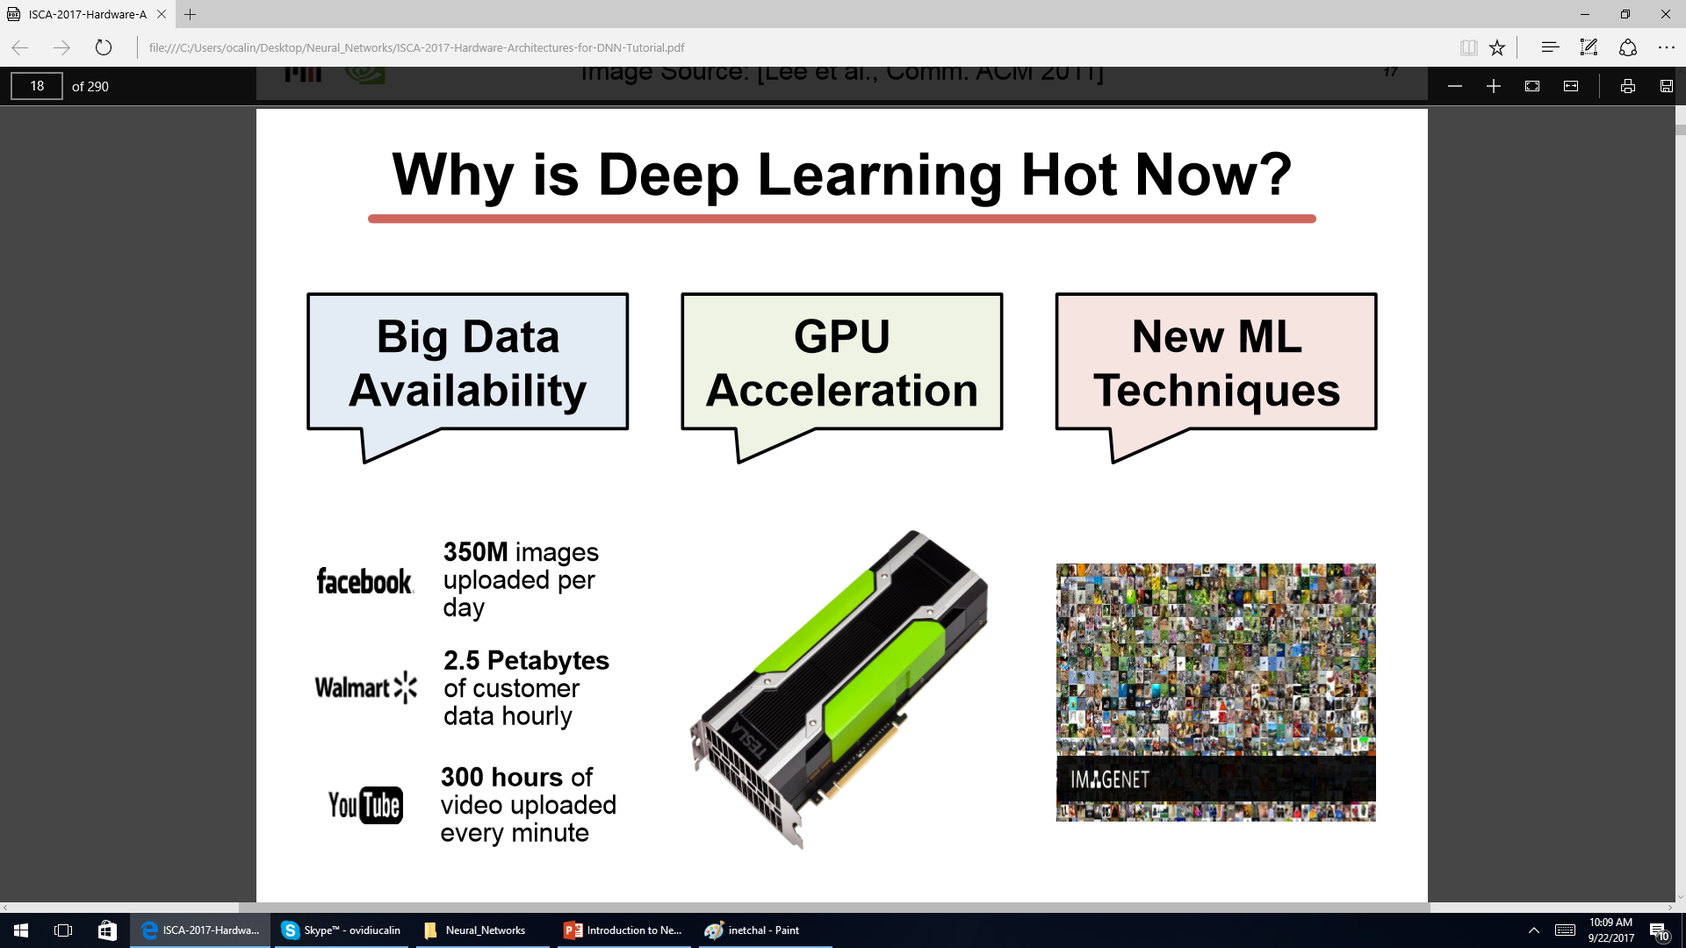

Slide 33
Training Data sets
datasets included the public Street View House Numbers
various versions of the ImageNet dataset
Imagent ~256x256 pixels (color) 1000 Classes 1.3M Training
Pascal VOC – 11k images – Object Detection – 20 classes
MS COCO – 300k images – Detection, Segmentation – Recognition in context
Google Open Images (~9M images) – https://github.com/openimages/dataset
Youtube-8M (8M videos) – https://research.google.com/youtube8m/
AudioSet (2M sound clips) – https://research.google.com/audioset/index.html

Slide 34
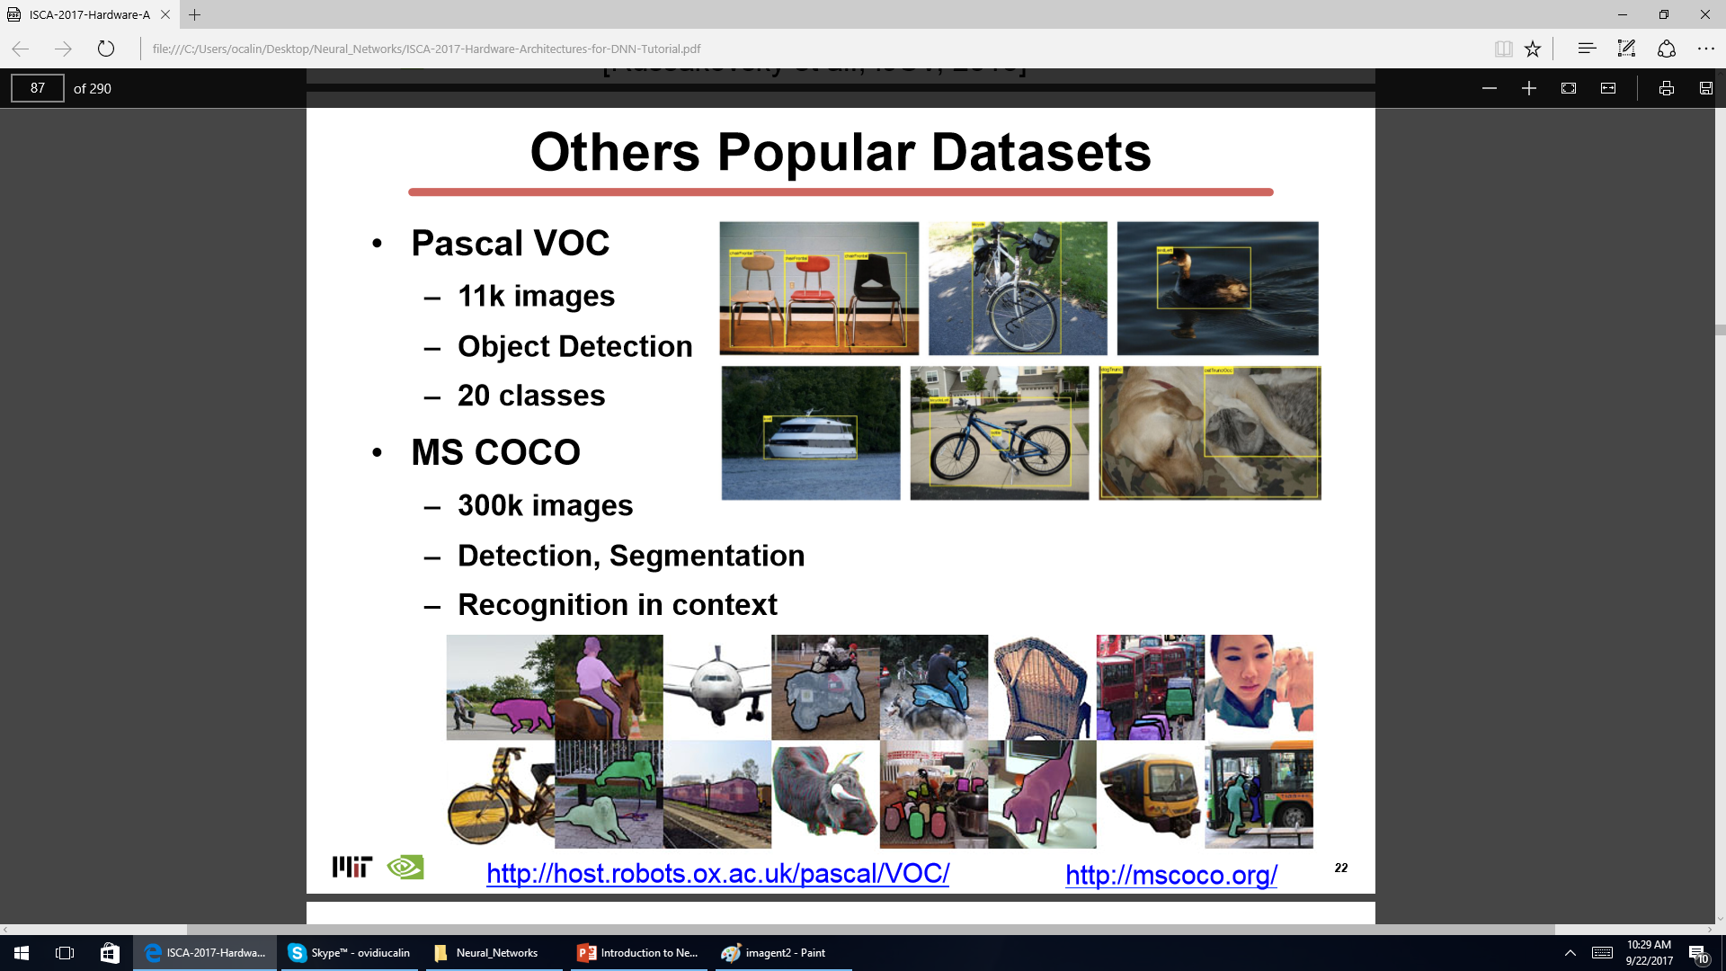

Slide 35
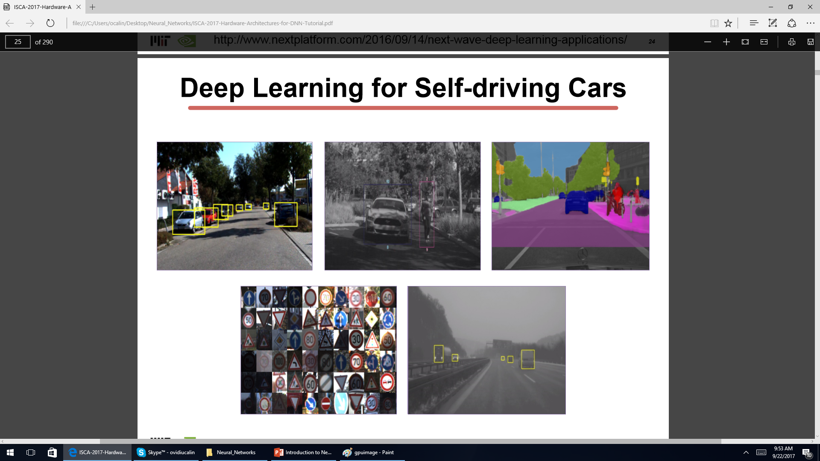

Slide 36
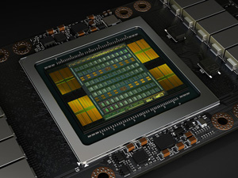
Hardware - from CPU to GPU
Intel Knights Landing (2016)
Nvidia PASCAL GP100 (2016)
Nvidia VOLTA GV100 (2017)
Nvidia DGX-1 (2016)
Facebook’s Deep Learning Machine

Slide 37
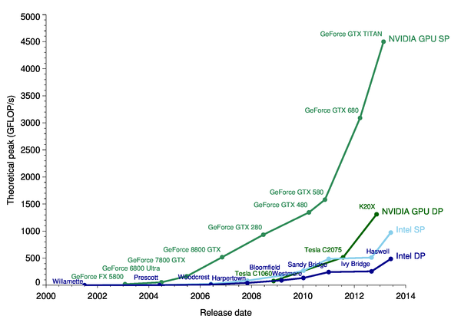
Hardware - from CPU to GPU

Slide 38
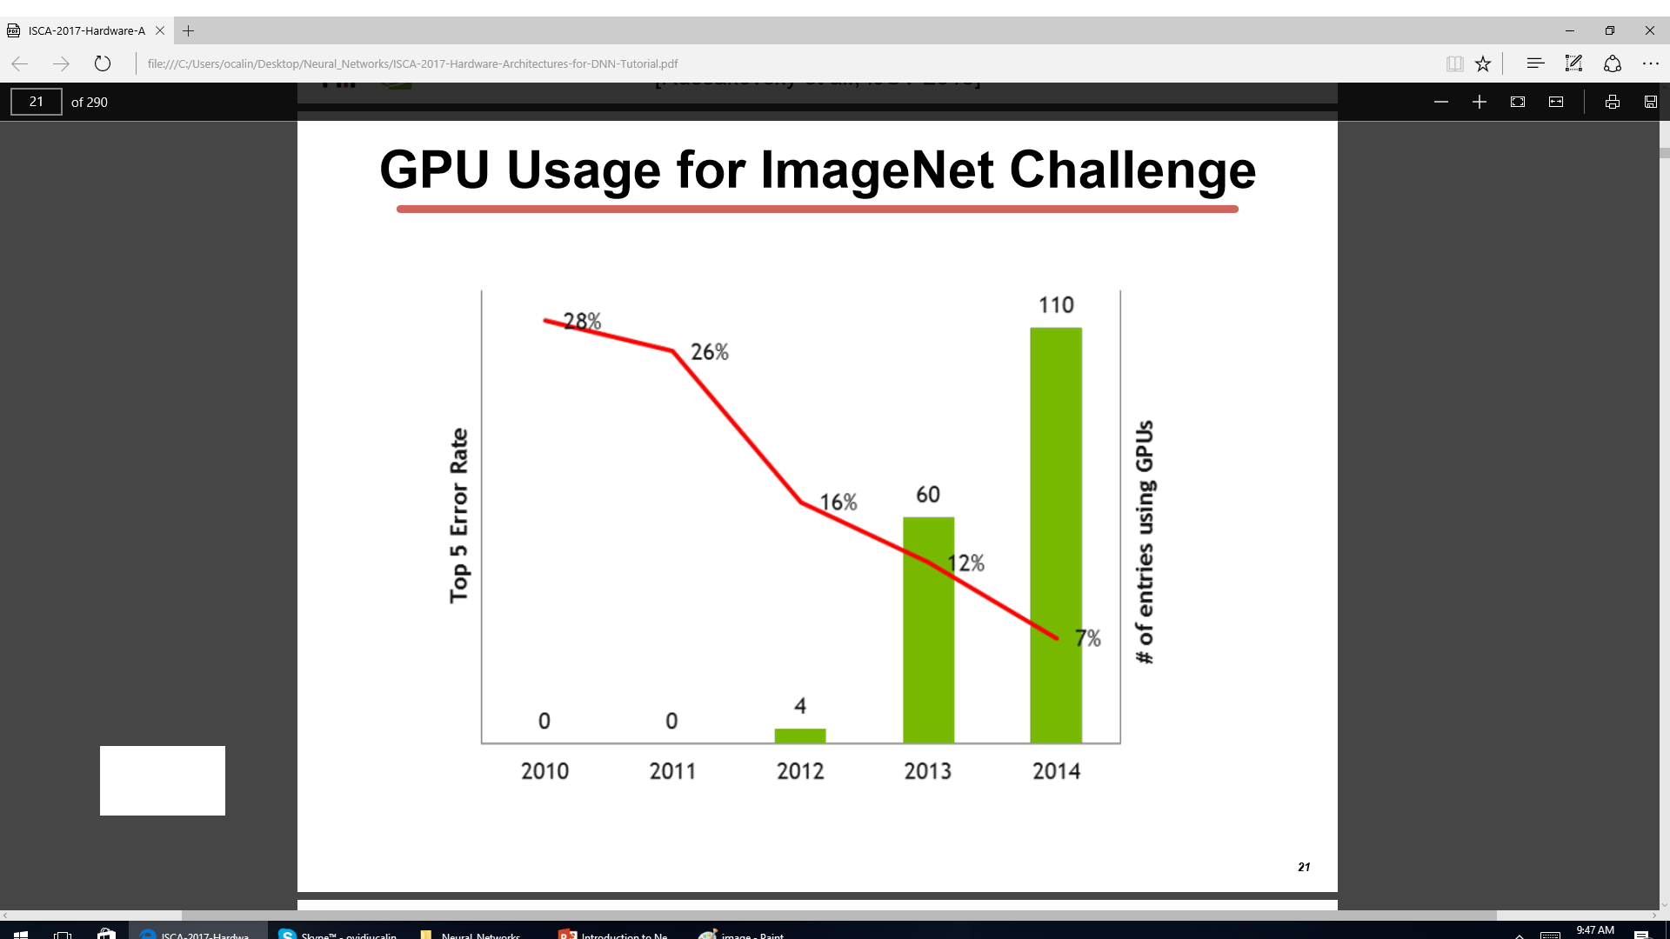

Slide 39
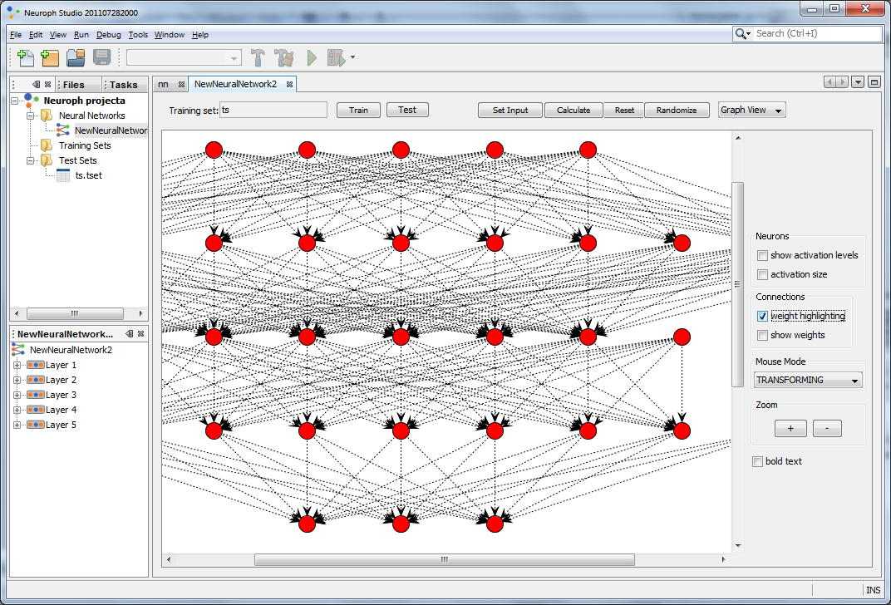
advances in software infrastructure
Theano (2012)
PyLearn2 (2013)
Torch (2011)
DistBelief (2012)
Caffe (2013)
MXNet (2015)
TensorFlow (2015)
Neuroph (java neural network framework)

Slide 40
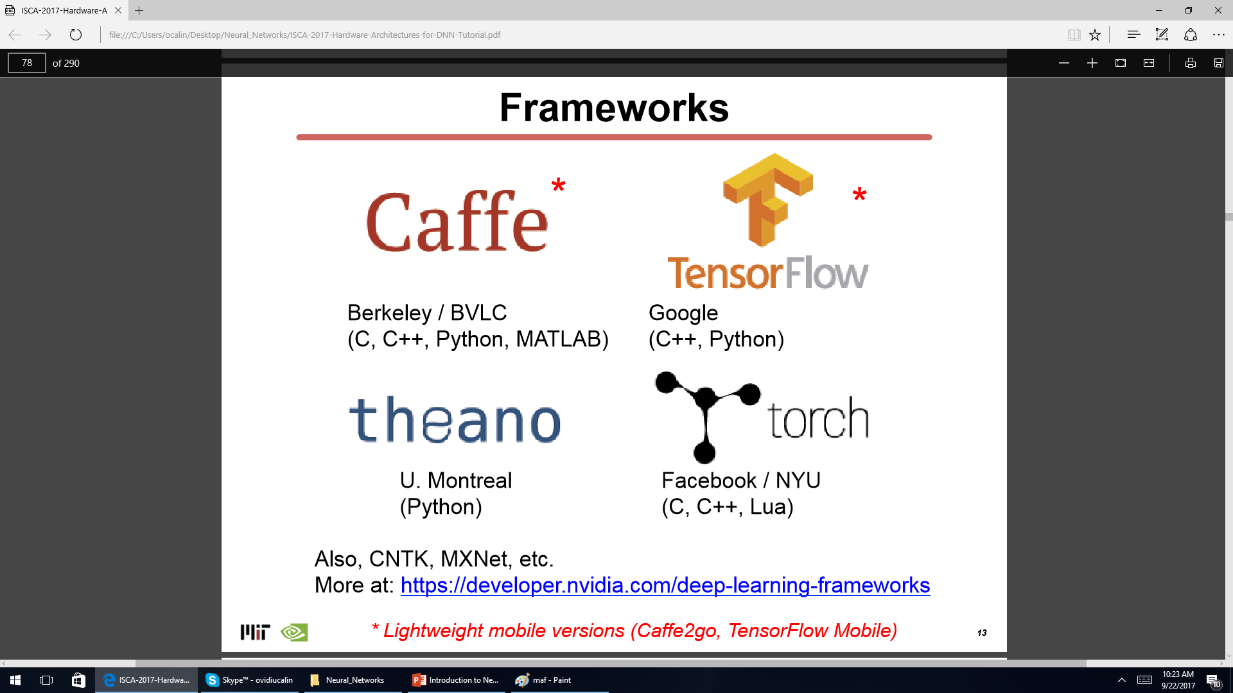

Slide 41
Recipe for the New paradigm
Training Data sets (pictures, sounds, letters, characters, etc. with labels)
NN model (feed forward, autoencoder, Hopfield Network, Boltzmann machine, etc.)
Cost (error) function – to be minimized w.r.t. the synaptic weights
Optimization procedure (gradient descent, annealing, hessian method, etc.)

Slide 42
Neural networks
See link:
http://www.asimovinstitute.org/neural-network-zoo/

Slide 43
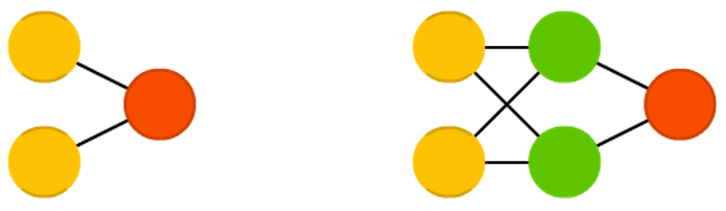
Feed forward NN
Perceptrons and Feed forward neural feed information from the front to the back.
Neural networks are often described as having layers, where each layer consists of either input, hidden or output cells in parallel.
A layer alone never has connections and in general two adjacent layers are fully connected.

Slide 44
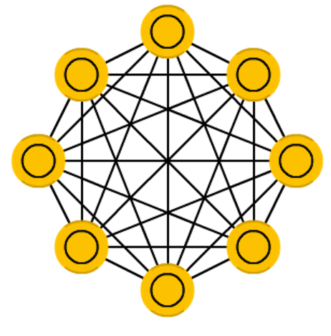
Hopfield NN
A Hopfield network is a network where every neuron is connected to every other neuron
it is a completely entangled plate of spaghetti as even all the nodes function as everything
Each node is input before training, then hidden during training and output afterwards.
Introduced by Hopfield, 1982

Slide 45
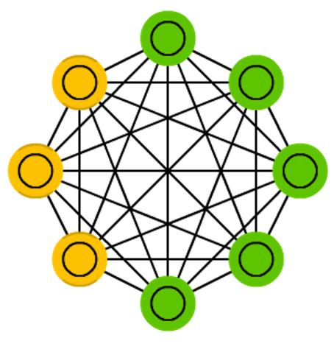
Boltzmann machines
Boltzmann machines (BM) are a lot like HNs, but: some neurons are marked as input neurons and others remain “hidden”.
The input neurons become output neurons at the end of a full network update.
It starts with random weights and learns through back-propagation
one sets the input neurons to certain values after which the network is set free While free the cells can get any value and we repetitively go back and forth between the input and hidden neurons. The activation is controlled by a global temperature value, which if lowered lowers the energy of the cells. This lower energy causes their activation patterns to stabilize. The network reaches an equilibrium given the right temperature.
Invented by Hinton and Sejnowski, 1986

Slide 46
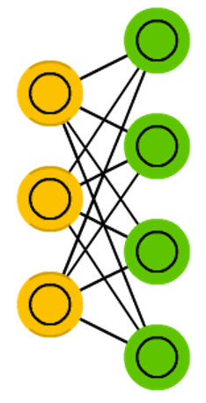
Restricted Boltzmann machines
Restricted Boltzmann machines are more restricted than BM
They don’t connect every neuron to every other neuron but only connect every different group of neurons to every other group
no input neurons are directly connected to other input neurons and no hidden to hidden connections are made either
Introduced by Smolensky, 1986.

Slide 47
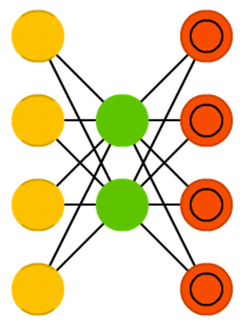
Autoencoders
encode information (compress, not encrypt) automatically
smaller hidden layers than the input and output layers.
symmetrical around the middle layer(s
The smallest layer almost always in the middle, the place where the information is most compressed
Everything up to the middle is called the encoding part,
everything after the middle is the decoding part
One can train them using backpropagation by feeding input and setting the error to be the difference between the input and what came out.
Bourlard, Hervé, and Yves Kamp.,1988

Slide 48


Slide 49
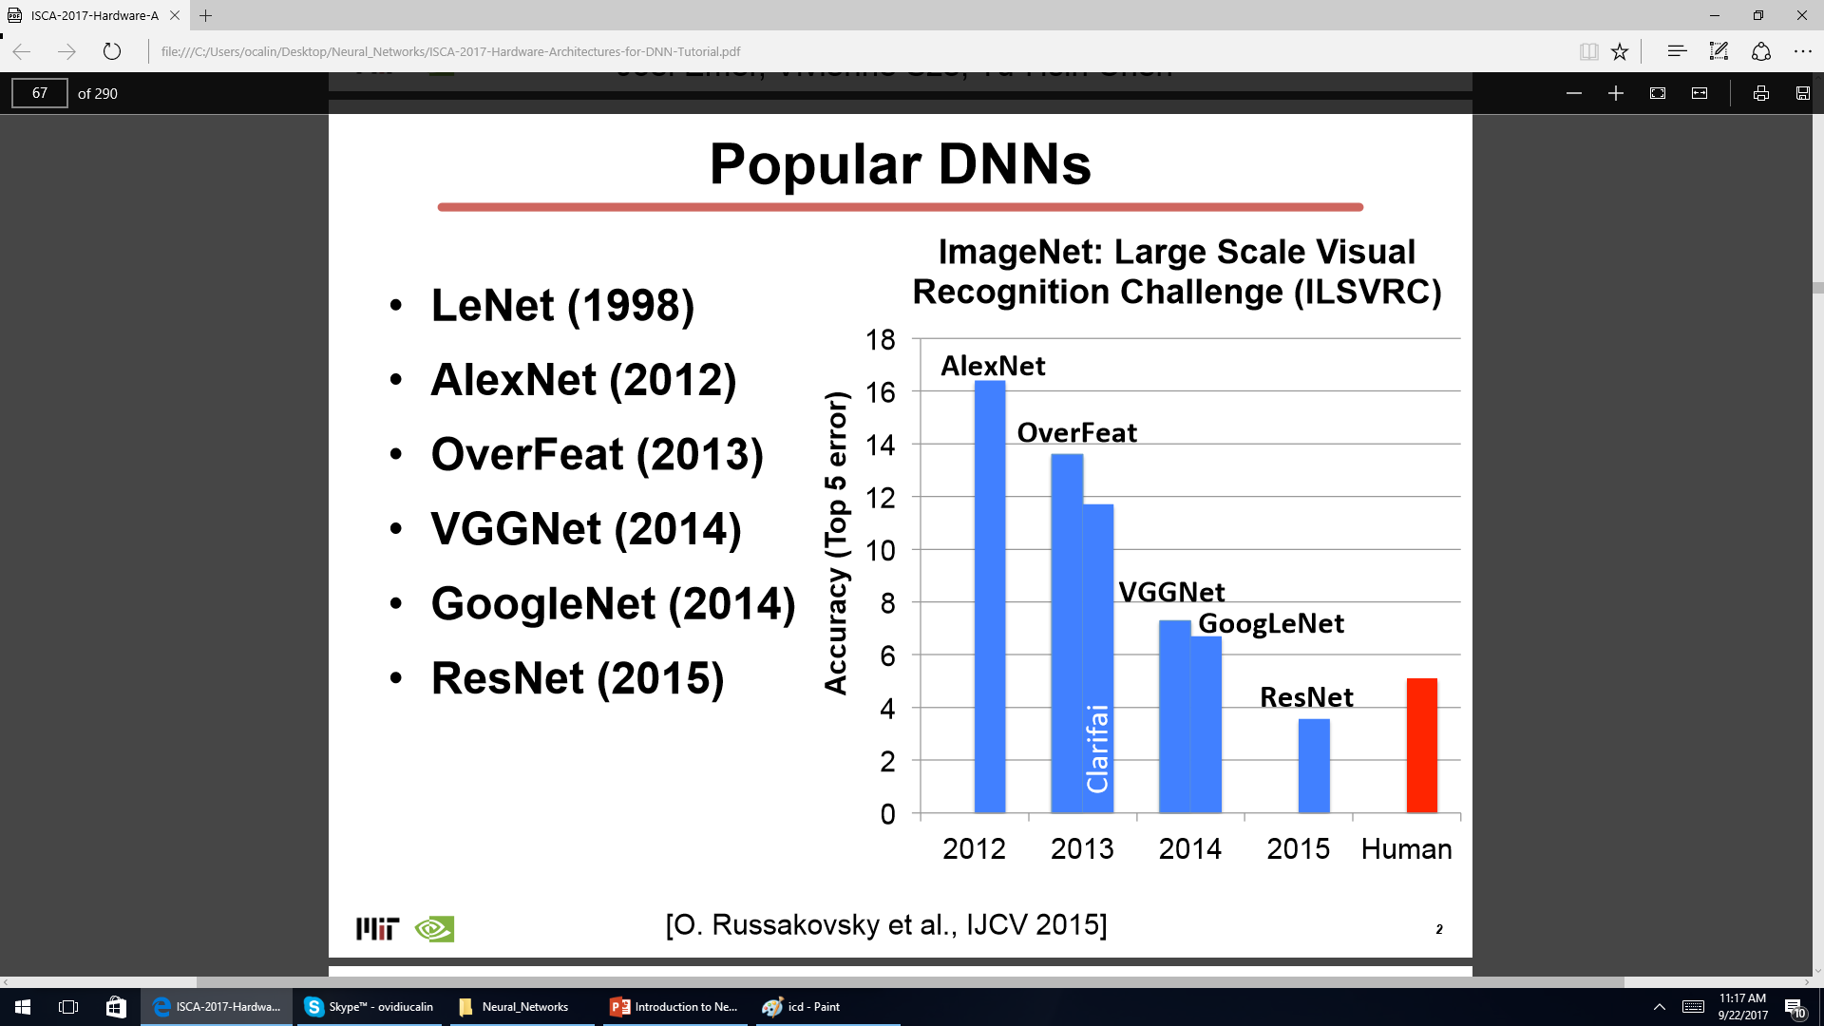

Slide 50
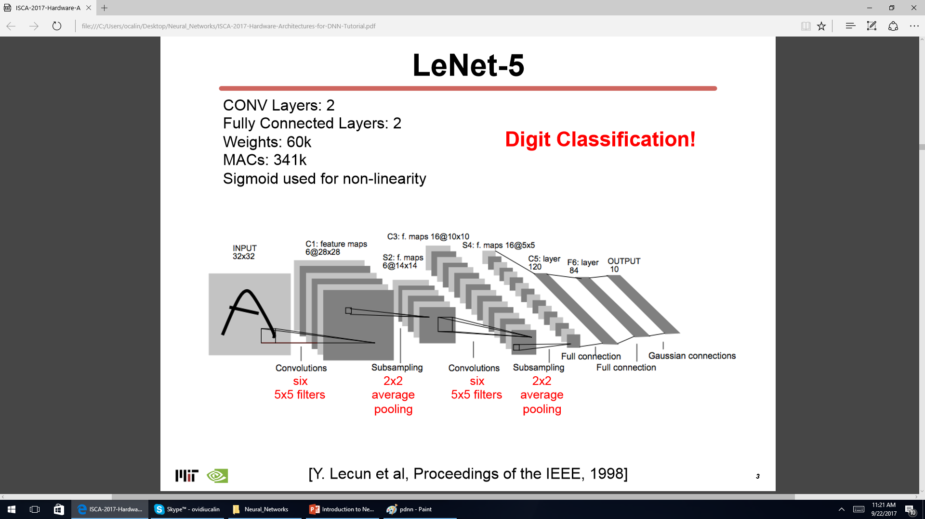

Slide 51
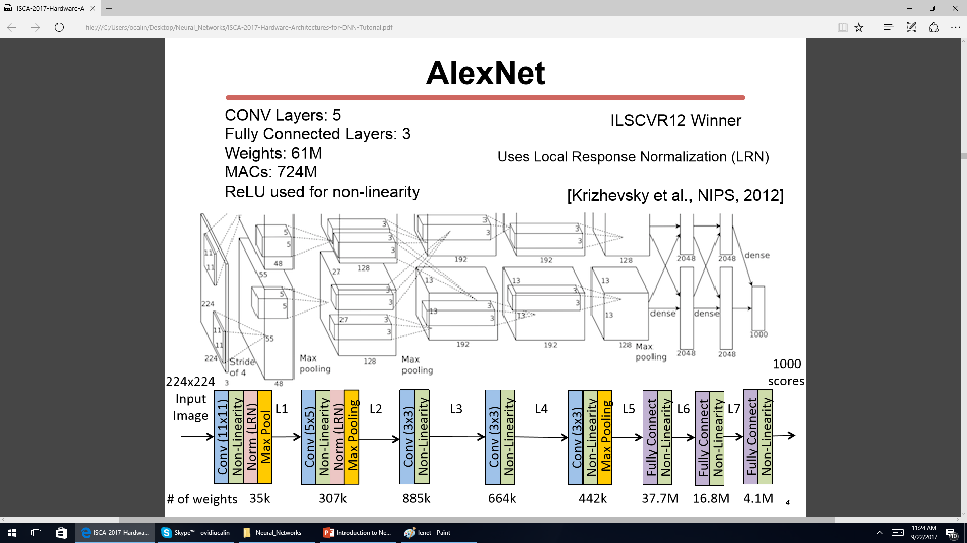

Slide 52
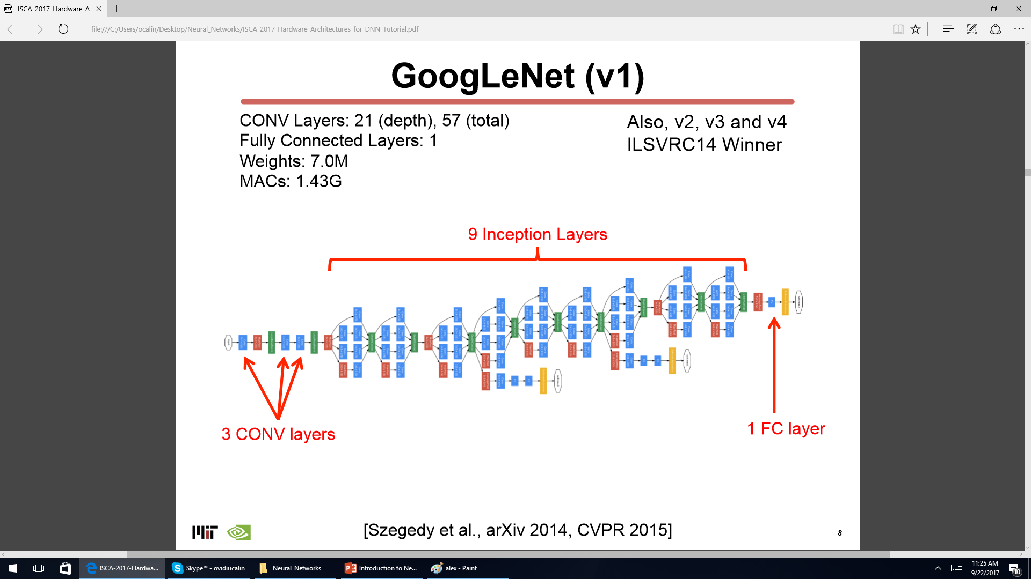

Slide 53
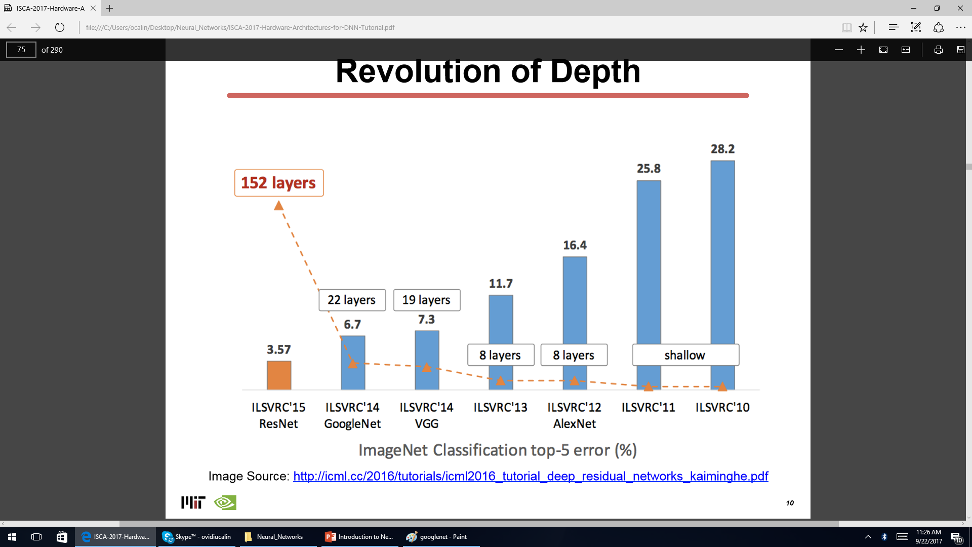

Slide 54
Books
Neural networks and deep learning by Michael Nielsen, 2017
Neural Networks-A Systematic Introduction, by Rau´l Rojas, 1996
Deep Learning, by Ian Goodfellow Yoshua Bengio Aaron Courville, 2016
Python Machine Learning, by Sebastian raschka, 2015

